Slide 1

Viagogo case study
Author: Xiaoman Dong
demiddrr@gmail.com

Slide 2

Contents
Introduction
Exploratory Data Analysis
Experiment Analysis
Result Analysis
Suggestions
Conclusion

Slide 3
1. Introduction
Statement
Suppose Viagogo release a change to the current home page: change the categories displayed to the 10 categories nearest to the user’s location with events rather than the 10 most popular categories based on sales from site.
Goal
Whether should we release this change
Metric
Conversion rate
Bounce rate
User acquisition rate

Slide 4
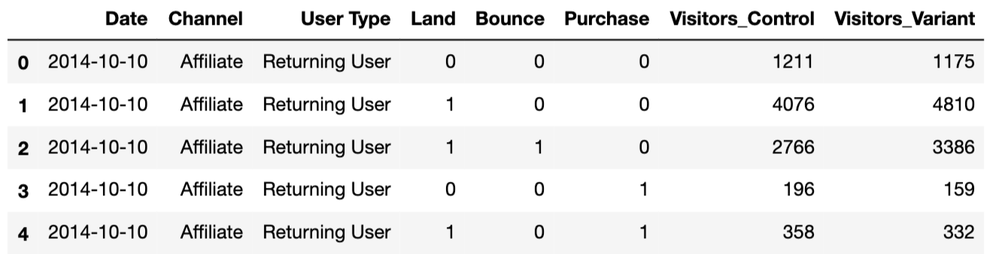
2. Exploratory data analysis
Data
1260 rows, 8 columns
Time range: 10/10/2014 – 10/30/2014
Number of control group: 2996337
Number of variant group: 3045853
Take a glimpse of dataset

Slide 5

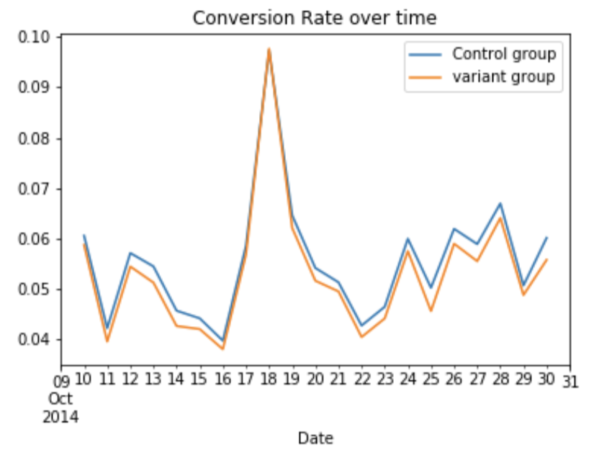
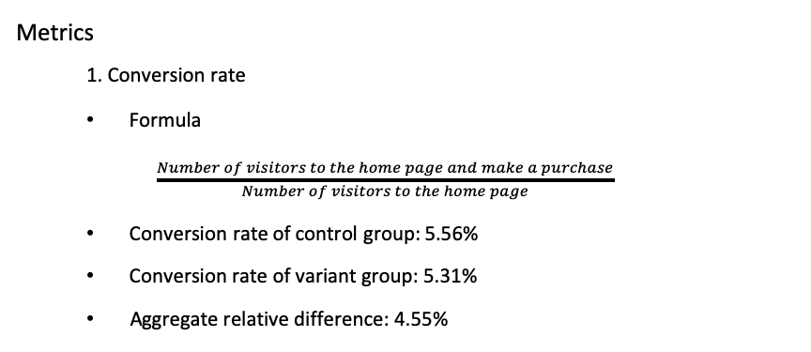

3. EXPERIMENT ANALYSIS
Metrics
1. Conversion rate
Formula
$\frac{Number of visitors to the home page and make a purchase}{Number of visitors to the home page}$
Conversion rate of control group: 5.56%
Conversion rate of variant group: 5.31%
Aggregate relative difference: 4.55%
Peak point
Date: 10/18/2014
Conversion rate:
9.8%

Slide 6
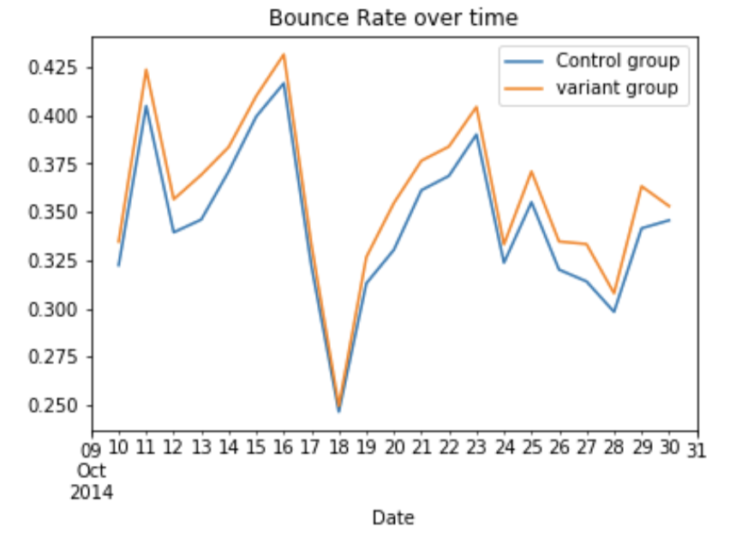
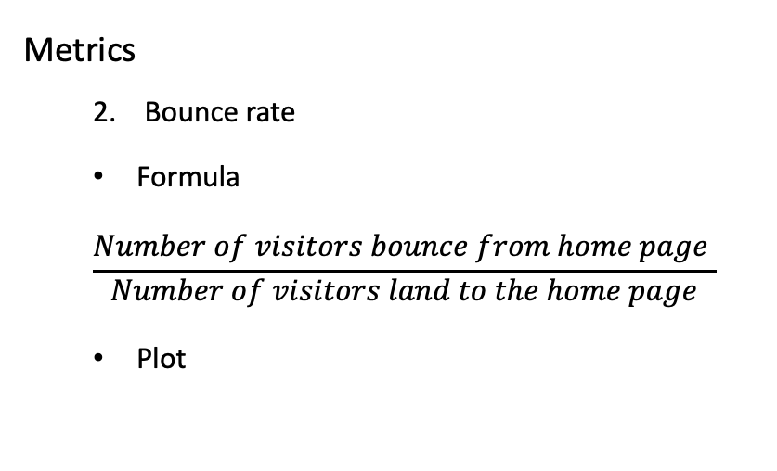
3. EXPERIMENT ANALYSIS
Metrics
Bounce rate
Formula
$$\frac{Number of visitors bounce from home page }{Number of visitors land to the home page}$$
Plot
The lowest point
Date: 10/18/2014
Bounce rate: 24%

Slide 7
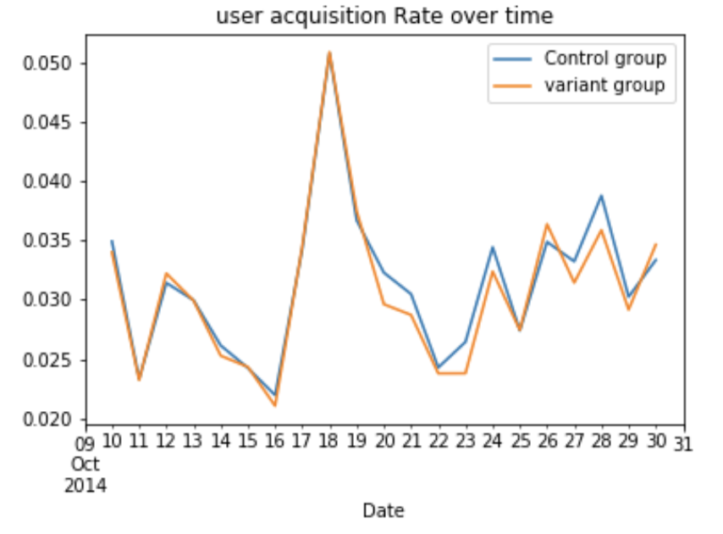
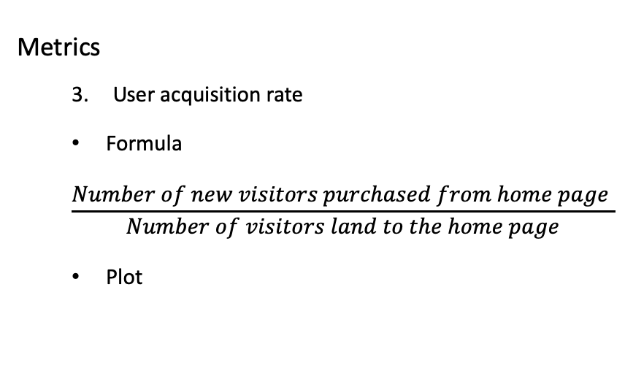
3. EXPERIMENT ANALYSIS
Metrics
User acquisition rate
Formula
$$\frac{Number of new visitors purchased from home page }{Number of visitors land to the home page}$$
Plot
For few days, the user acquisition rate of new feature increased

Slide 8
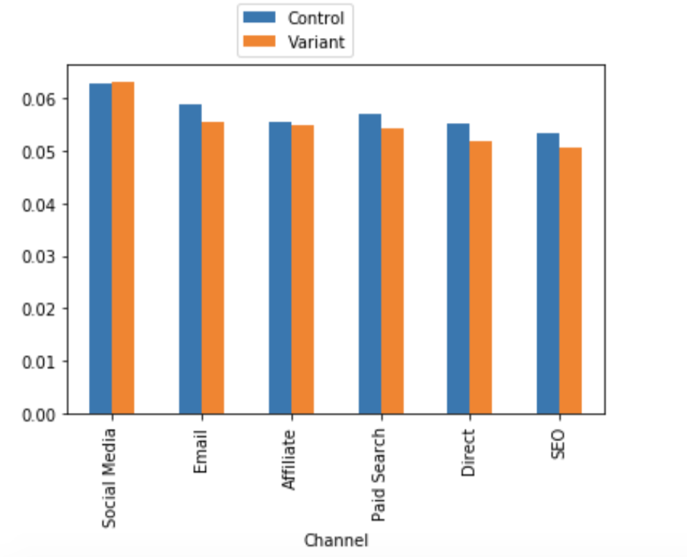
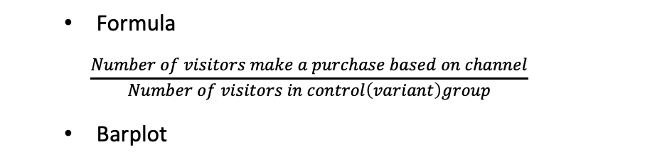

3. EXPERIMENT ANALYSIS
3. 1. 1 Conversion rate based on channel
Formula
$$\frac{Number of visitors make a purchase based on channel}{Number of visitors in control\left(variant\right)group}$$
Barplot
Conversion rate of new feature increase only on social media
Control conversion rate=6.28%
Variant conversion rate=6.31%

Slide 9
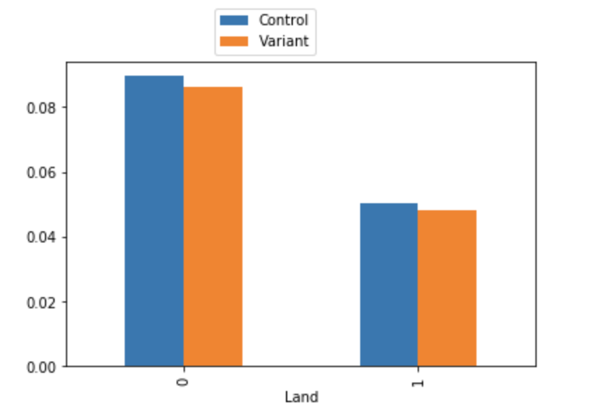
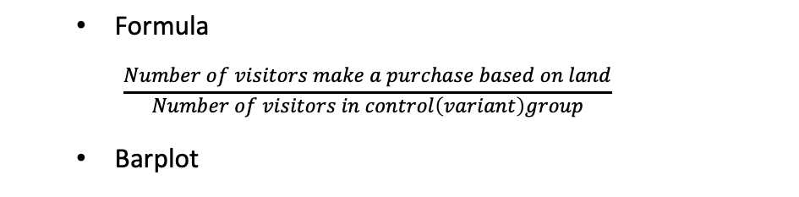
3. EXPERIMENT ANALYSIS
3. 1. 2 Conversion rate based on landing method
Formula
$$\frac{Number of visitors make a purchase based on land}{Number of visitors in control\left(variant\right)group}$$
Barplot
Conversion rates of variant group are always less than control group on 2 land methods

Slide 10
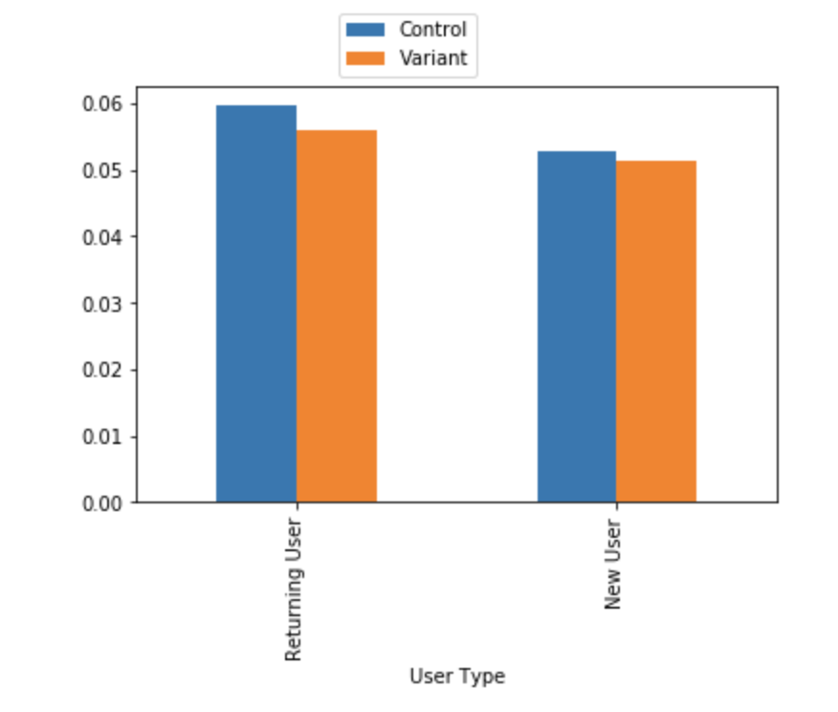
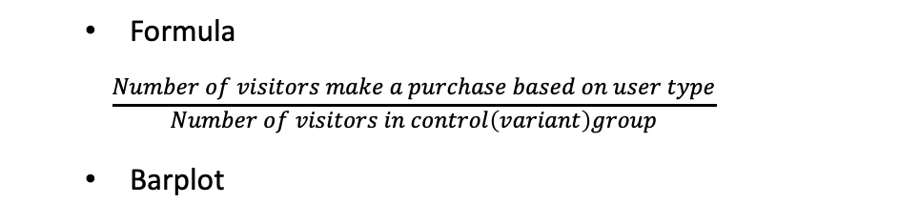
3. EXPERIMENT ANALYSIS
3. 1. 3 Conversion rate based on user type
Formula
$$\frac{Number of visitors make a purchase based on user type}{Number of visitors in control\left(variant\right)group}$$
Barplot
Conversion rates of variant group are always less than control group no matter returning or new users

Slide 11
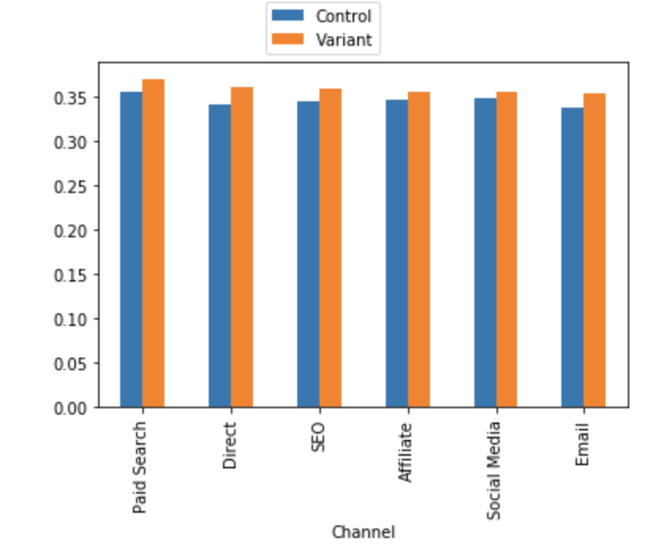
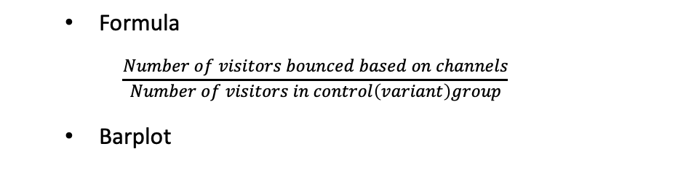
3. EXPERIMENT ANALYSIS
3. 2. 1 Bounce rate based on channels
Formula
$$\frac{Number of visitors bounced based on channels}{Number of visitors in control\left(variant\right)group}$$
Barplot
Bounce rates of new feature are higher than old feature no matter returning or new users

Slide 12
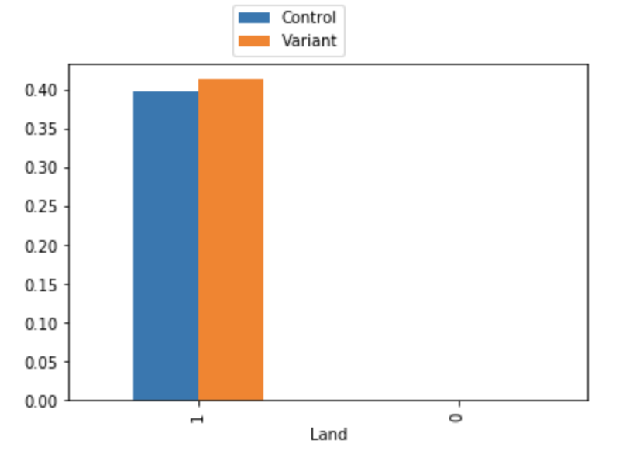
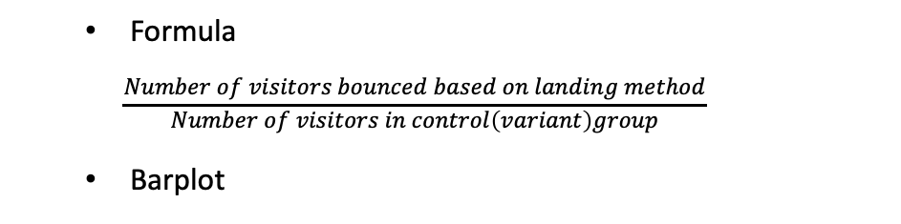
3. EXPERIMENT ANALYSIS
3. 2. 2 Bounce rate based on landing method
Formula
$$\frac{Number of visitors bounced based on landing method}{Number of visitors in control\left(variant\right)group}$$
Barplot
1. Bounce rates of variant group is higher than control group for users who land to home page directly.
2. No bounce rate for both group in terms of people who jump to home page from another site of our page

Slide 13
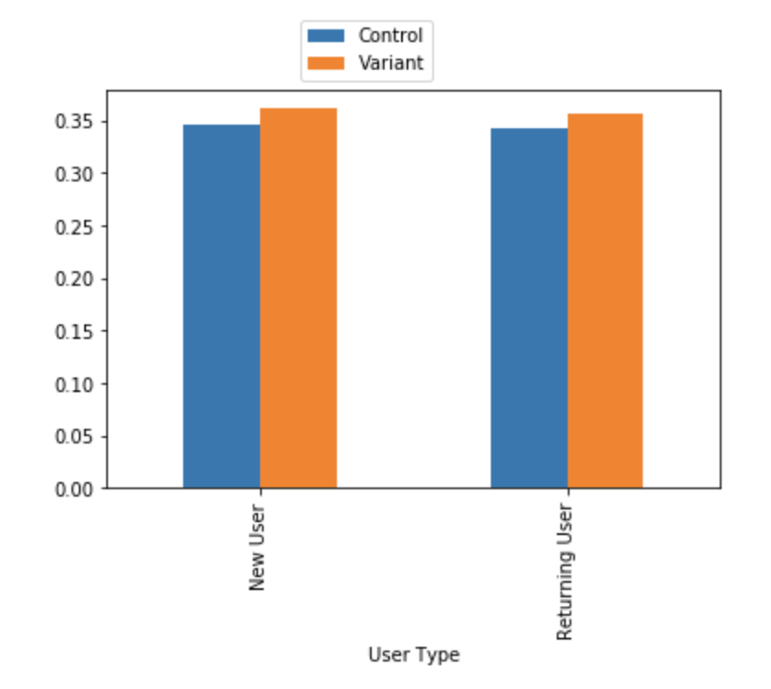
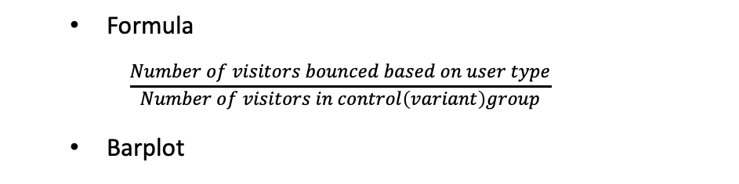
3. EXPERIMENT ANALYSIS
3. 2. 3 Bounce rate based on user type
Formula
$$\frac{Number of visitors bounced based on user type}{Number of visitors in control\left(variant\right)group}$$
Barplot
Bounce rates of variant group are higher than control group for both groups

Slide 14
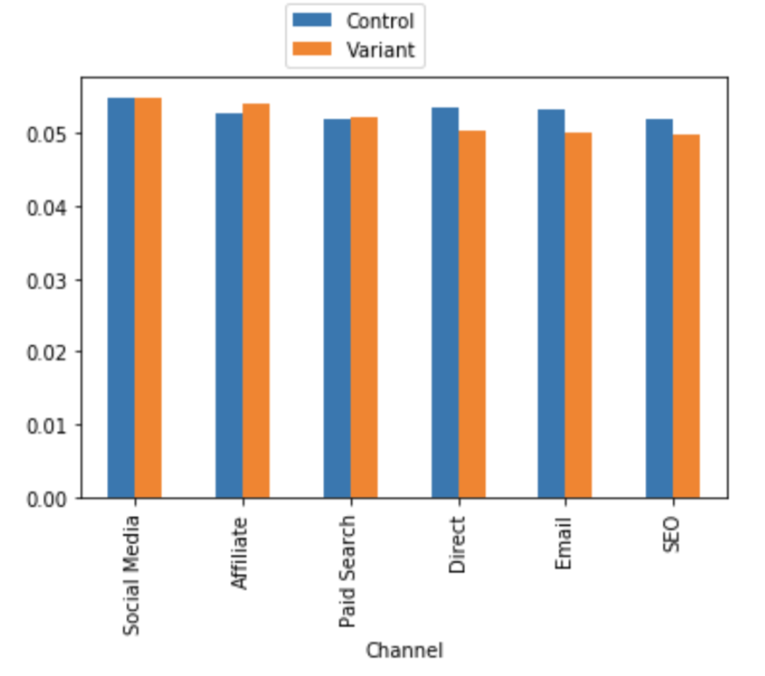
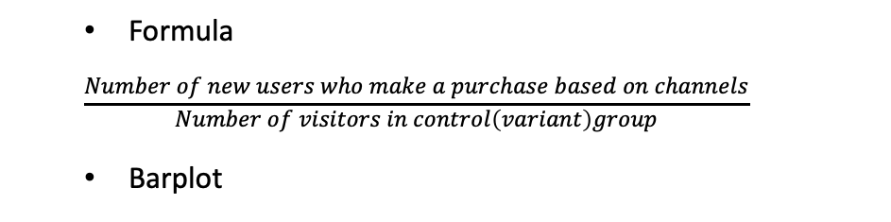

3. EXPERIMENT ANALYSIS
3. 3. 1 User acquisition rate based on channels
Formula
$$\frac{Number of new users who make a purchase based on channels}{Number of visitors in control\left(variant\right)group}$$
Barplot
New feature seems gained more new users on affiliate channel

Slide 15
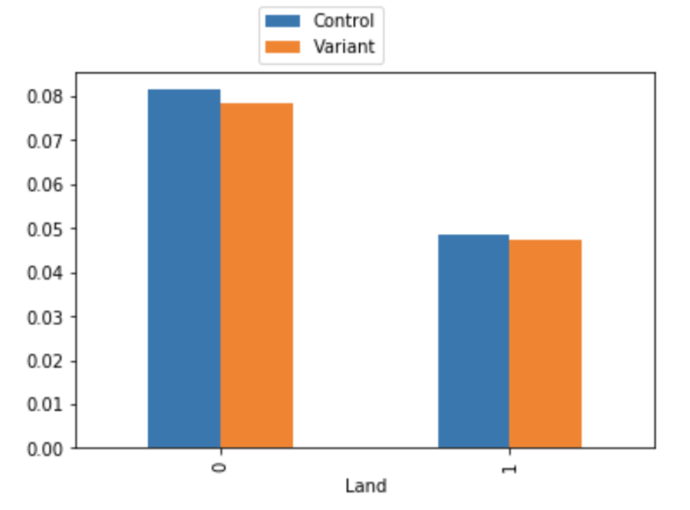
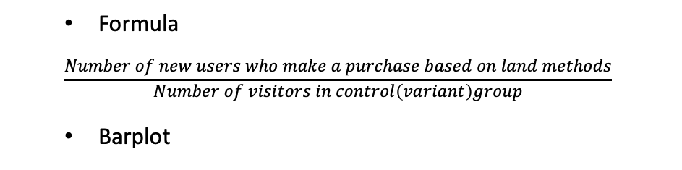
3. EXPERIMENT ANALYSIS
3. 3. 2 User acquisition rate based on landing method
Formula
$$\frac{Number of new users who make a purchase based on land methods}{Number of visitors in control\left(variant\right)group}$$
Barplot
The new feature does not help to acquire new users

Slide 16
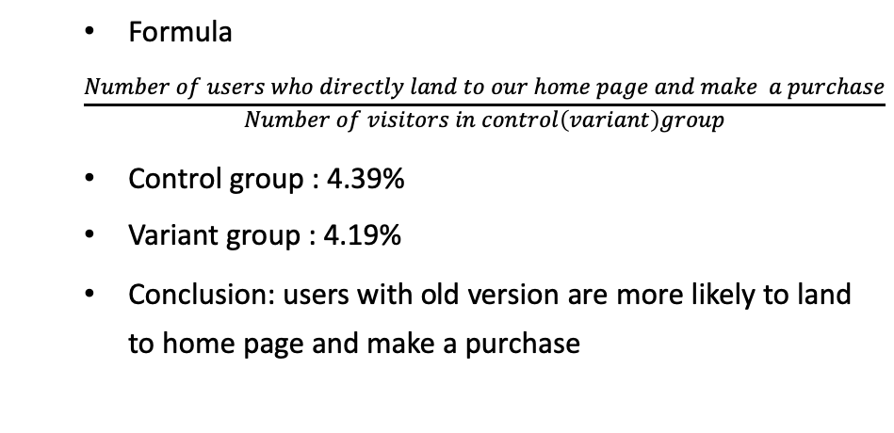
3. EXPERIMENT ANALYSIS
3. 4 User direct purchased rate on two groups
Formula
$$\frac{Number of users who directly land to our home page and make a purchase}{Number of visitors in control\left(variant\right)group}$$
Control group : 4.39%
Variant group : 4.19%
Conclusion: users with old version are more likely to land to home page and make a purchase

Slide 17

Result analysis
Hypothesis Test 1
Until now, we could see that the conversion rate of variant group is always less than the control group. In order to get a confident conclusion, we should build a hypothesis test to see whether the conversion rate difference between variant and control group is significant.
Thus, we do a hypothesis testing as below:
Null hypothesis:
conversion rate of control = conversion rate of variant
Alternative hypothesis:
conversion rate of variant < conversion rate of control

Slide 18
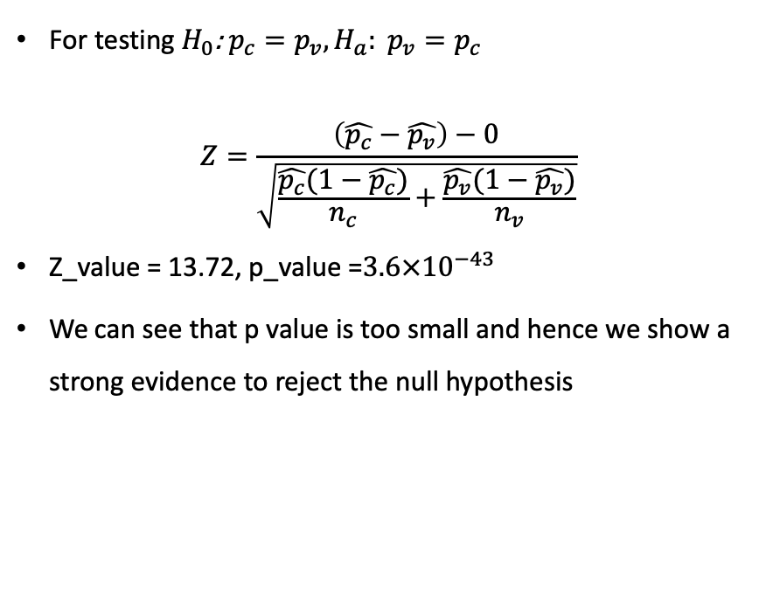
Result analysis
Two sample one side z test
For testing $H_{0}$: $p_{c}=p_{v}, H_{a}: p_{v}=p_{c}$
$$Z=\frac{\left(\hat{p_{c}}−\hat{p_{v}}\right)−0}{\sqrt{\frac{\hat{p_{c}}(1−\hat{p_{c}})}{n_{c}}+\frac{\hat{p_{v}}(1−\hat{p_{v}})}{n_{v}}}}$$
Z_value = 13.72, p_value =$3.6×{10}^{−43}$
We can see that p value is too small and hence we show a strong evidence to reject the null hypothesis

Slide 19
Result analysis
Hypothesis Test 2
Since we catch a conversion rate difference of social between two groups, hence we would like to build a hypothesis test to see whether the conversion rate of social media difference between variant(6.31%) and control group (6.28%)is significant.
Thus, we do a hypothesis testing as below:
Null hypothesis:
conversion rate of control = conversion rate of variant
Alternative hypothesis:
conversion rate of variant > conversion rate of control

Slide 20
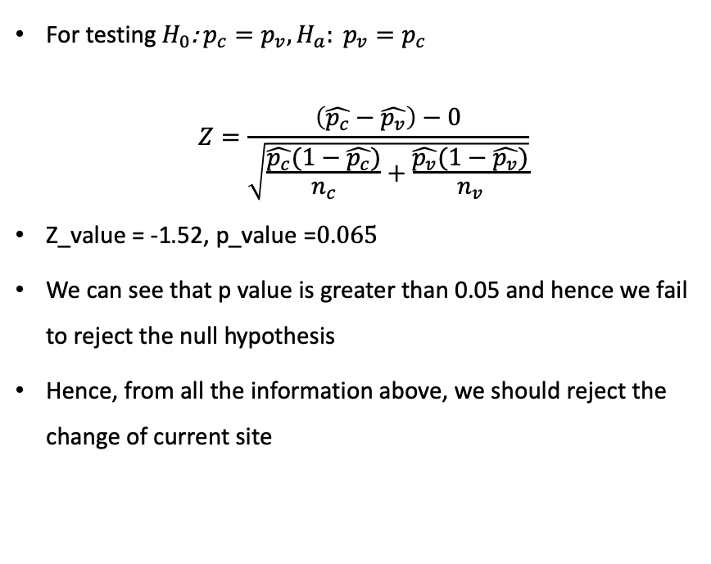
Result aNALYSIS
Two sample one side z test
For testing $H_{0}$: $p_{c}=p_{v}, H_{a}: p_{v}=p_{c}$
$$Z=\frac{\left(\hat{p_{c}}−\hat{p_{v}}\right)−0}{\sqrt{\frac{\hat{p_{c}}(1−\hat{p_{c}})}{n_{c}}+\frac{\hat{p_{v}}(1−\hat{p_{v}})}{n_{v}}}}$$
Z_value = -1.52, p_value =$0.065$
We can see that p value is greater than 0.05 and hence we fail to reject the null hypothesis
Hence, from all the information above, we should reject the change of current site

Slide 21
conclusion
Based on three metrics that we used, the conversion rate and bounce rate of new version are worse than old version. There is only a small increase of conversion rate based on social media channel, and a slight increase of user acquisition rate based on affiliate.
In general, this new change does not improve the current performance.
Additional data required
User’s behavior characteristics
Purchase timing (morning/afternoon/night)
Purchase genre(festival/concerts/sports/theatre)
Past purchasing history
User’s demographic characteristics
Ip address/Country/Zip code
Age
Gender
Education level

Slide 22



THANK YOU
Xiaoman Dong
+1 (646)275-9917
demiddrr@gmail.com

